Slide 1
Fintech Final Project - 3
Ethereum Smart Contracts – For Mortgage Lending
May 14th,2024
Nikhil Karol Prerna Mehta Sobi Iyver Amir Nizam

Slide 2
Introduction
OBJECTIVE :The project aims to create a Decentralized mortgage system using Ethereum smart contracts.
SMART CONTRACT: Developed a Solidity smart contract called “ Mortgage” to manage mortgage loans.
FUNCTIONALITY : The smart contract allows users to submit loan requests , approve or decline loans, make payments and withdraw remaining balances.
CONTRACT FEATURES: Tracks loan details such as loan amount, monthly payments, remaining balance , and homeowner’s address

Slide 3
Executive Summary
MINIMUM INCOME REQUIREMENT: Implemented a requirement for a minimum monthly income for loan approval.
INTEREST CALCULATION: Added an interest calculator to calculate interest on the loan amount.
LATE FEE OPTION: Included a late fee option for borrowers to pay late fees along with their payments.
STREAMLIT INTERFACE: Developed a Streamlit web interface for users to interact with the smart contract.
DATA VISUALIZATION: Displayed contract data such as homeowner address and loan amount using the Streamlit app.
ETHEREUM INTEGRATION: Connected the Streamlit app to a local Ethereum node to interact with the smart contract. Handled Ethereum transactions for loan submissions, approvals, declines, and payments.
TESTING: Tested the functionality of the smart contract and the Streamlit interface to ensure proper operation.

Slide 4
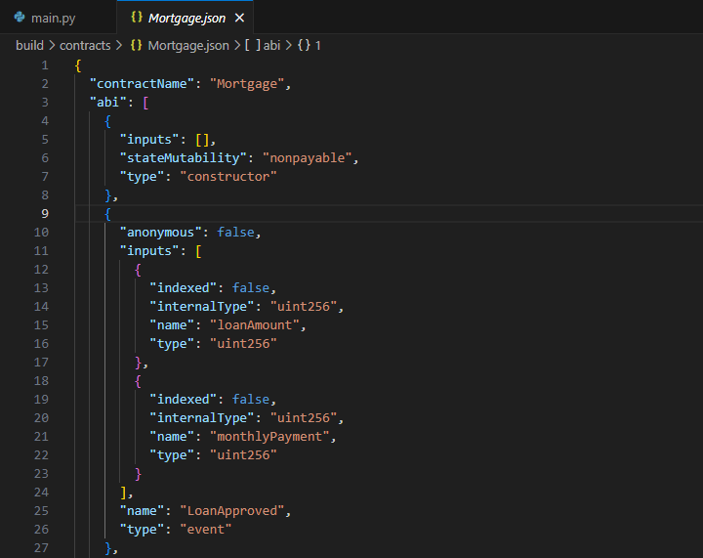
Structure of Solidity Program – Introduction about Json
We have used ABI standardized way to interact with Ethereum smart contracts, allowing other contracts to understand how to call the functions within the contract. Various functions as follows:
Contract name
Constructor
Loan approved
Loan amount
Monthly payment
Remaining Balance

Slide 5
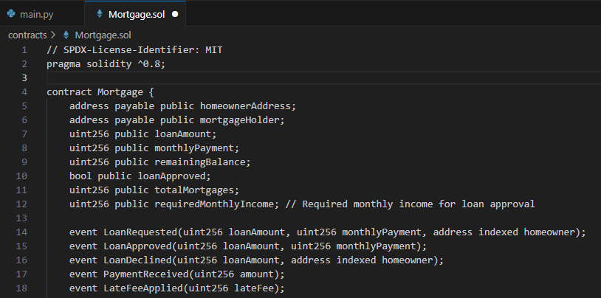
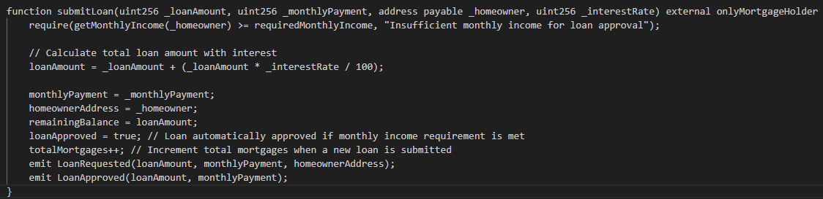
Mortgage. Sol
It basically defines the smart contract named Mortgage, which facilitates the process of granting mortgages between two parties: the mortgage holder (the entity that deploys the contract) and the homeowner (the borrower). Key components as follows:
Homeowners address
Mortgage holder
Loan amount and etc..
This code represents a function in a smart contract written in Solidity, a language used for programming smart contracts.
Key Components functions as follows:
Get monthly income
Loan Approval/Decline and etc..

Slide 6
Mortgage. Sol
Mortgage Holder Functions are as follows:
SubmitLoan: Initiates a loan request for a homeowner. Calculates the total loan amount with interest and sets loan details. Automatically approves the loan if the homeowner meets the income requirement. Emits events for loan requested and approved.
DeclineLoan: Rejects a pending loan request. Emits a loan declined event.
MakePayment: Allows the mortgage holder to receive payments from the homeowner. Applies late fees if applicable. Updates remaining balance and loan status. Emits a payment received event.

Slide 7
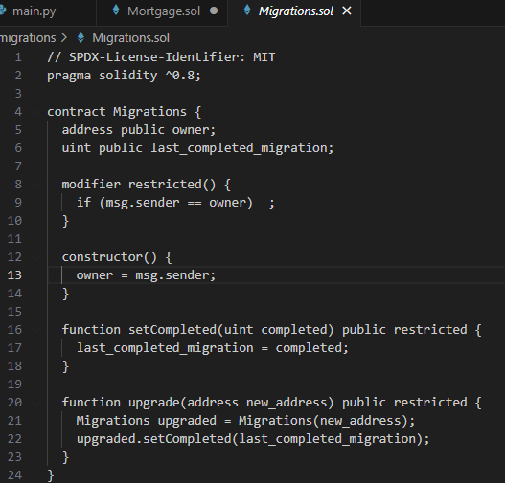
Migration. Sol
The code accomplish the following:
Track of an owner address and index the last completed migration
Restricts other to access
On deployment sender become the owner.
Allows owner to update the index
Enables owner to upgrade the contact to new address and transferring the last completed migration index to new contract

Slide 8
Migration. Sol
Deploy Contract
Overall, this contract provides functionality for managing migrations and upgrading the contract to a new version while ensuring that only the owner can perform these actions. It's commonly used in the context of smart contract development, especially when managing the deployment and upgrading of contracts.
Initialize the owner
Last Completed Migration
Owners Call
Upgrade Contract

Slide 9
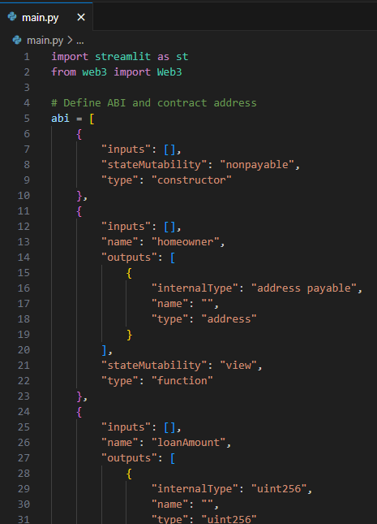
Main.py – 1 (Input and special functions)
Streamlit imported as st
Web3 from the web3
We have defined the ABI to interact with smart contract, which includes the details of the functions names as input represent a special functions like homeowner, loan amount, monthly payment , interest rate, make payment, approve & decline the loan.
These inputs represents the submit loan functions of the contract and takes four input parameters example (a) loan amount (b) monthly payment (c ) interest rate
Overall this code defines, the ABI for interacting with smart contract likely to handle the loan, this includes functions for the submitting the loan

Slide 10
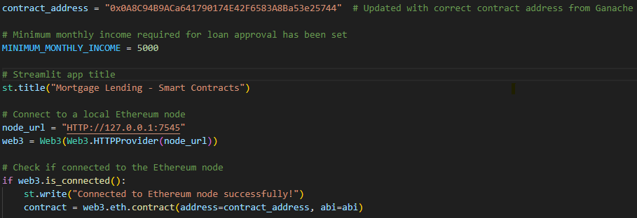
Main.py – 2 (Contract Address)
This represents the Ethereum address of a deployed smart contract.
We have set the minimum monthly income to qualify for the loan.
Set the title for the streamlit application as Mortgage Lending – Smart Contracts.
This URL pointing to the local node

Slide 11
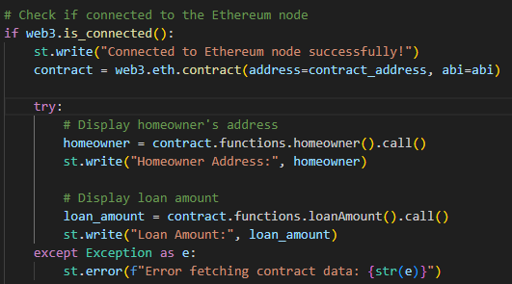
Main.py – 3 (web3 instance connected to an ETH node)
This represents the web3 instance is connected to Ethereum node, retrieves data from a deployed smart particularly the homeowner and loan amount. If any error occurs the error message will prompt to address the issue.

Slide 12
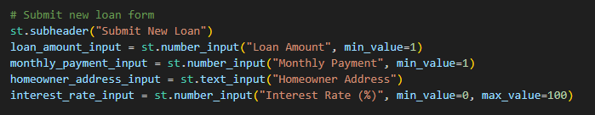
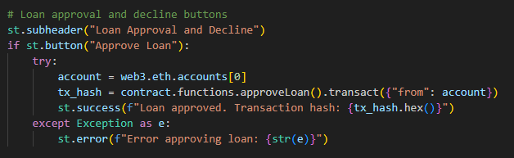
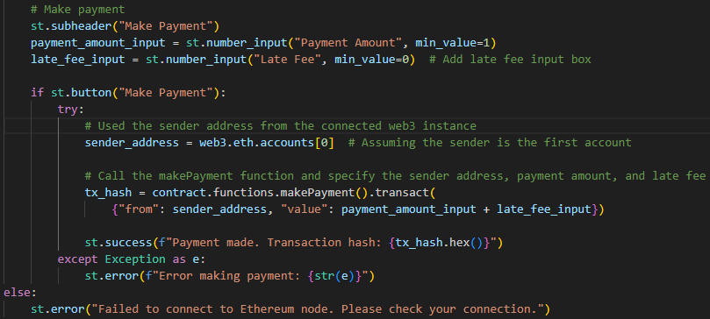
Main.py - 4
This represents the code segment users with a form to submit a new loan application, verifies if their monthly income meets the minimum requirement of loan approval, and allows users to know the loan status whether it is approved or declined. Additionally, if the loan approved, this functions will allow the user to make payments towards their loans.

Slide 13
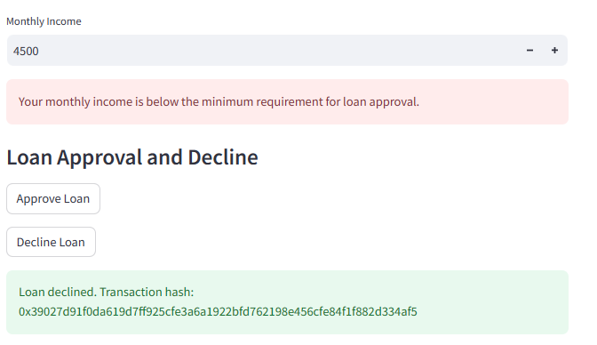
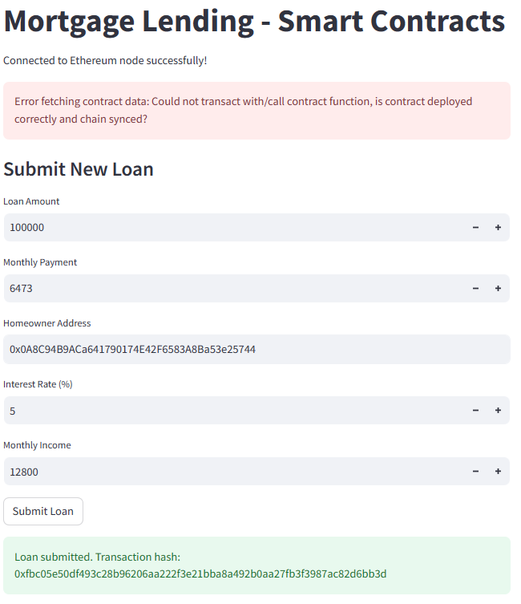
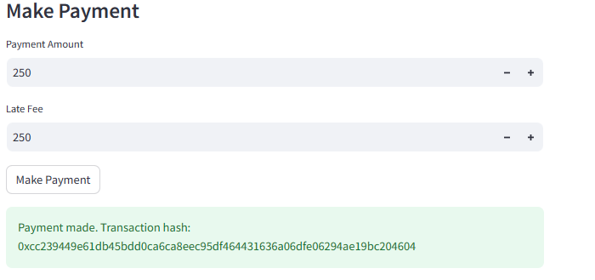
Mortgage Lending – Local Host (main · Streamlit)

Slide 14
Potential Improvements or Additional Features:
Implementing more robust access control mechanisms.
Adding events or functions for tracking loan history and payments.
Introducing interest calculations for more realistic mortgage scenarios.
Implementing mechanisms for handling missed payments or late fees.
Integrating with external sources for credit checks or loan approval processes.
Adding additional security features, optimizing gas usage, focusing on user experience.

Slide 15
Conclusion
The main.py serves as the backbone of a user-friendly interface for managing the mortgage lending activities on the blockchain. By streamlining the process of submitting loan applications, facilitating efficient loan approval and declines and enabling seamless payment management, the application empowers users to navigate the complexities of mortgage transactions and allow users about the status of their actions.

Slide 16


